Slide 1
Smart Recuritment System
Artifical Intelligence

Slide 2


Group Members
Muhammad Atiq Abdullah
Muhammad Uzair
FA20 – BCS - 047
FA20 – BCS - 040

Slide 3
Abstract
This project is an AI based Smart Recruitment System. It is an intelligent system that will help interviewers in choosing the best applicant for their company. Benefits of this smart system are:
Time Saving
Shortlists top profiles
A thorough understanding of a person's talents and skills

Slide 4
Tools and Technology Used
Jupyter
Linked In
Code Editing Tool
Platform For Data Scrapping
Selenium
Tkinter
Used for Web Scrapping
Used For making Python GUI
Beautiful Soup
MS Excel
For Scrapping Html Tags Data
For Storing Scrapped Data

Slide 5
01
System will open links, do scrapping and gather required data
List of Functionalities
02
Gathered data will be then stored in an Excel File
03
Using Genetic Algorithm Sysytem will find the best candidate
04
System will Display the data of candidate on UI

Slide 6
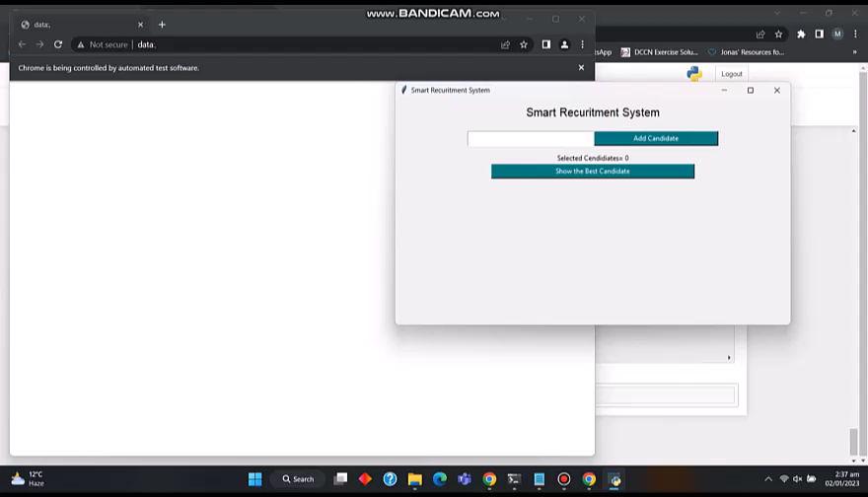
Video Demo

